Slide 1
Section 10.1
Polar Coordinates
Copyright © 2012 Pearson Education, Inc. Publishing as Prentice Hall.

Slide 2
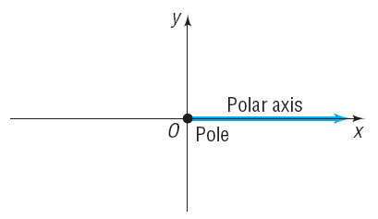
Copyright © 2012 Pearson Education, Inc. Publishing as Prentice Hall.

Slide 3
Copyright © 2012 Pearson Education, Inc. Publishing as Prentice Hall.

Slide 4
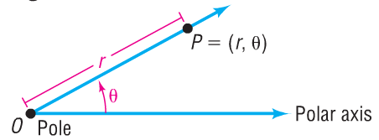
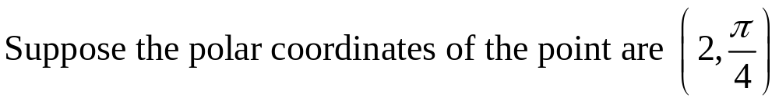
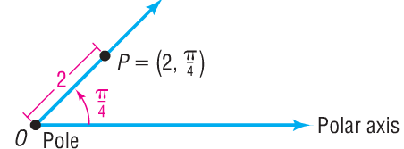
Copyright © 2012 Pearson Education, Inc. Publishing as Prentice Hall.

Slide 5
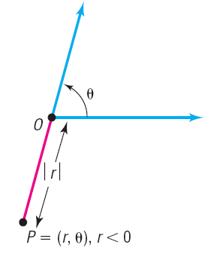

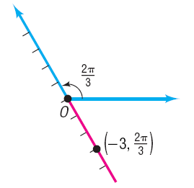
Copyright © 2012 Pearson Education, Inc. Publishing as Prentice Hall.

Slide 6

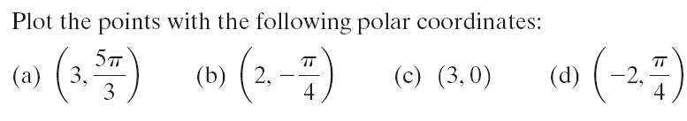
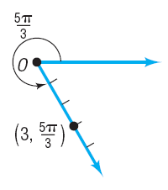

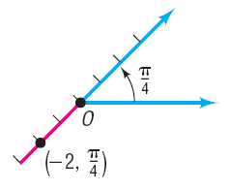
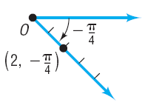
Copyright © 2012 Pearson Education, Inc. Publishing as Prentice Hall.

Slide 7
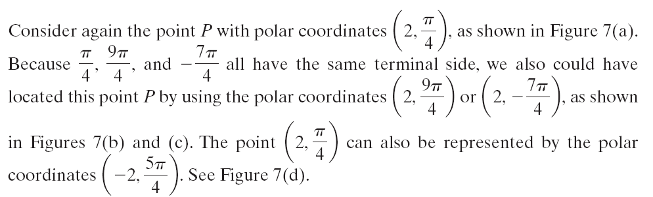
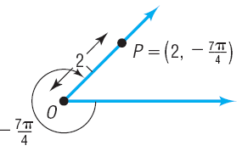
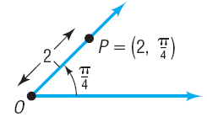
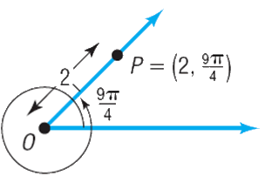
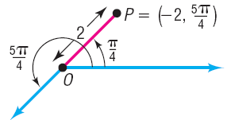
Copyright © 2012 Pearson Education, Inc. Publishing as Prentice Hall.

Slide 8
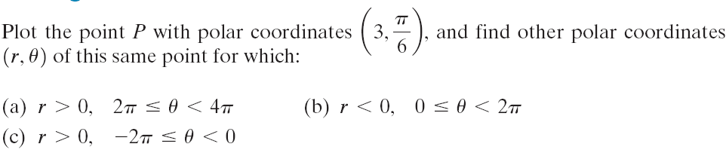
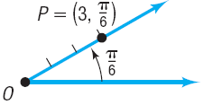
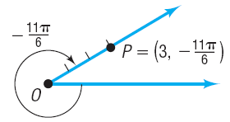
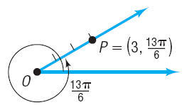
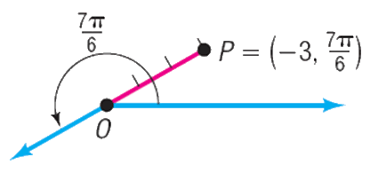
Copyright © 2012 Pearson Education, Inc. Publishing as Prentice Hall.

Slide 9

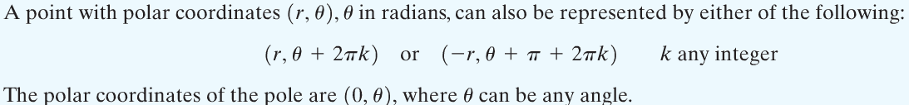
Copyright © 2012 Pearson Education, Inc. Publishing as Prentice Hall.

Slide 10
Copyright © 2012 Pearson Education, Inc. Publishing as Prentice Hall.

Slide 11

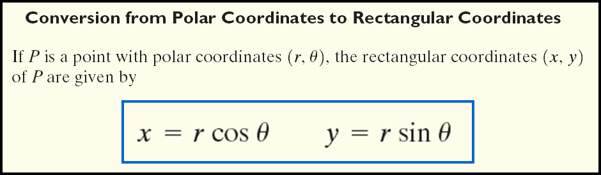
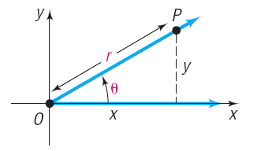
Copyright © 2012 Pearson Education, Inc. Publishing as Prentice Hall.

Slide 12
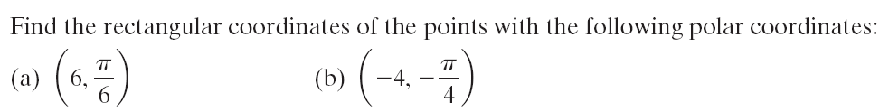
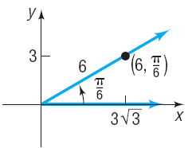




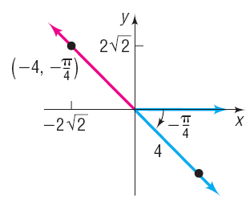


Copyright © 2012 Pearson Education, Inc. Publishing as Prentice Hall.

Slide 13
Copyright © 2012 Pearson Education, Inc. Publishing as Prentice Hall.

Slide 14
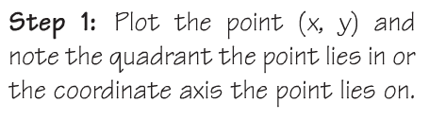
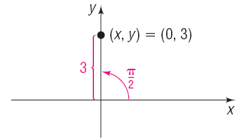




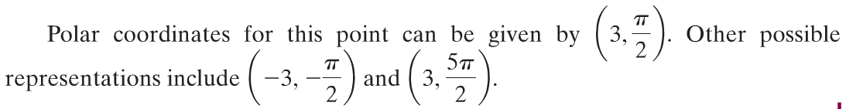
Copyright © 2012 Pearson Education, Inc. Publishing as Prentice Hall.

Slide 15
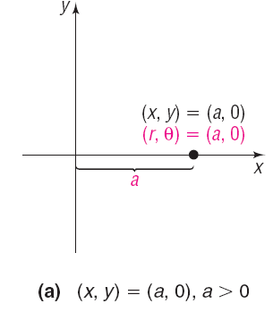
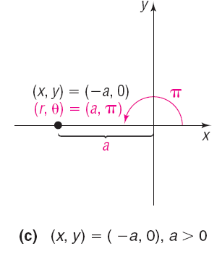
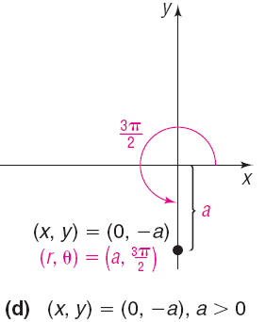
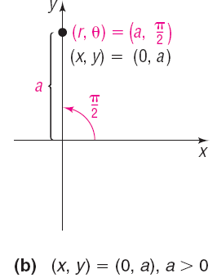
Copyright © 2012 Pearson Education, Inc. Publishing as Prentice Hall.

Slide 16
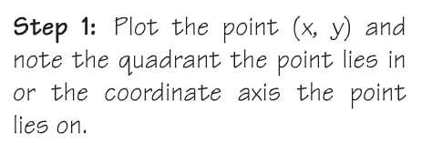
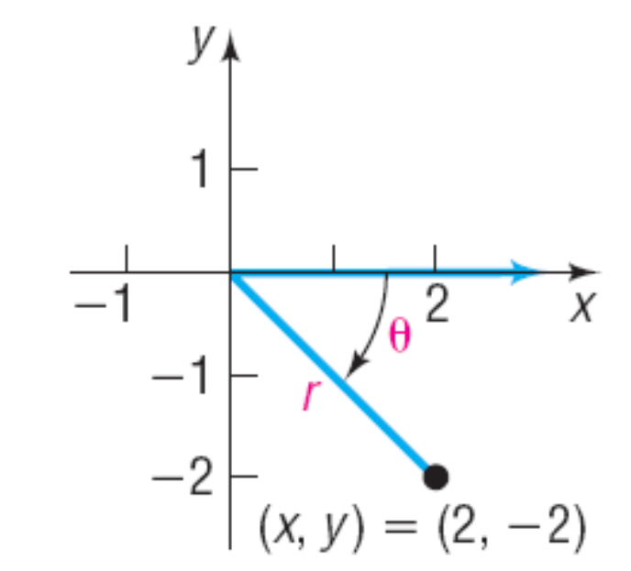
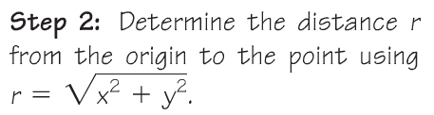



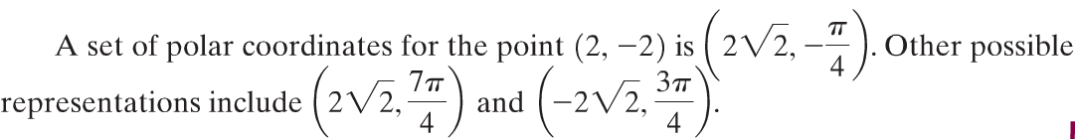
Copyright © 2012 Pearson Education, Inc. Publishing as Prentice Hall.

Slide 17
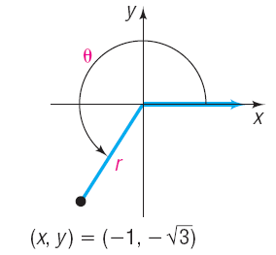
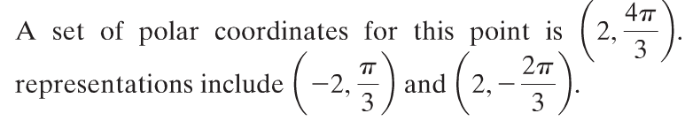
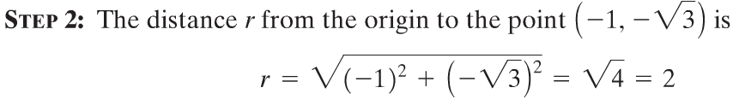
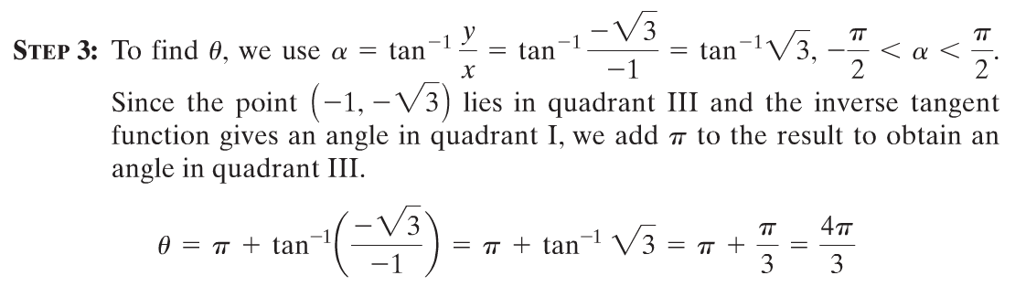
Copyright © 2012 Pearson Education, Inc. Publishing as Prentice Hall.

Slide 18
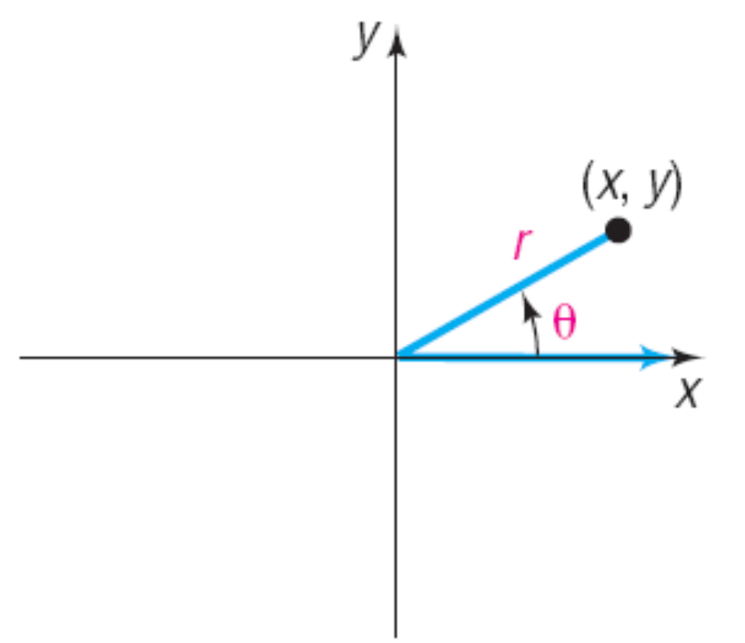
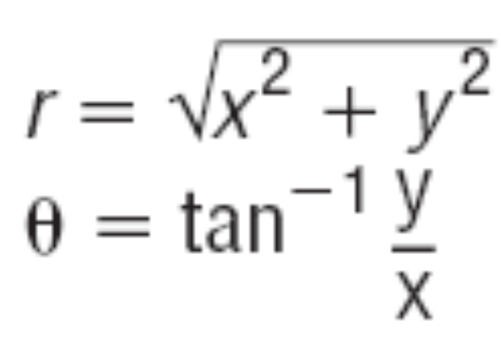
Copyright © 2012 Pearson Education, Inc. Publishing as Prentice Hall.

Slide 19
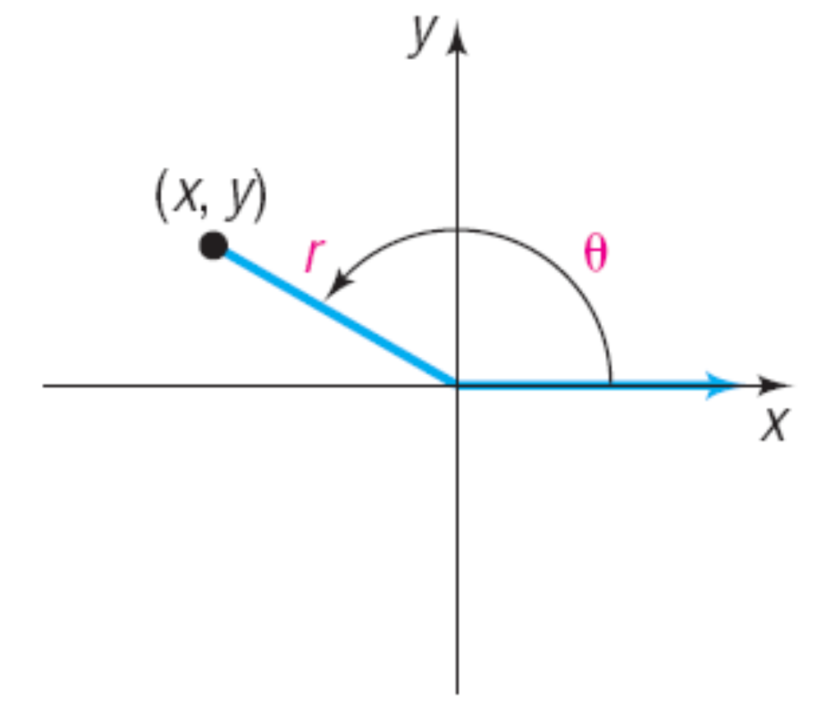
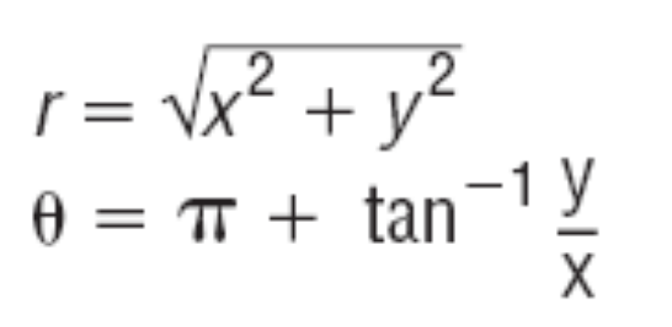
Copyright © 2012 Pearson Education, Inc. Publishing as Prentice Hall.

Slide 20
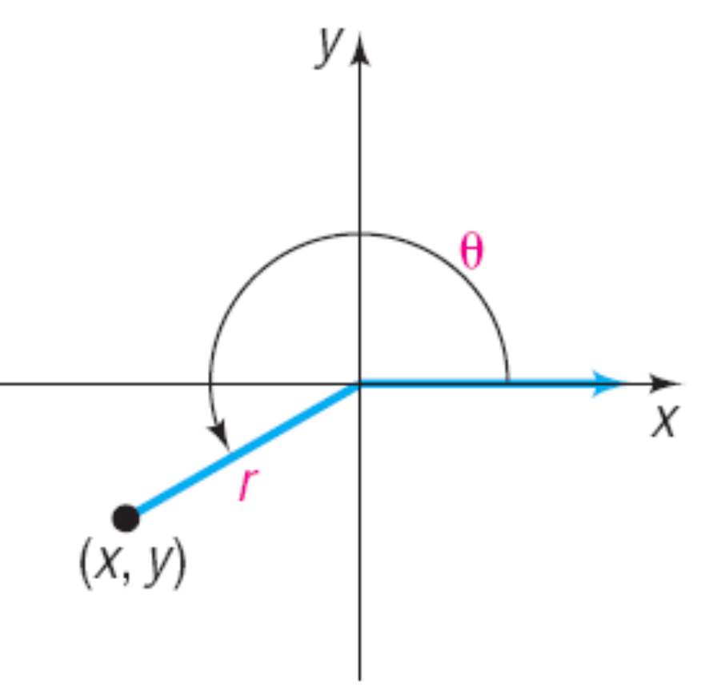
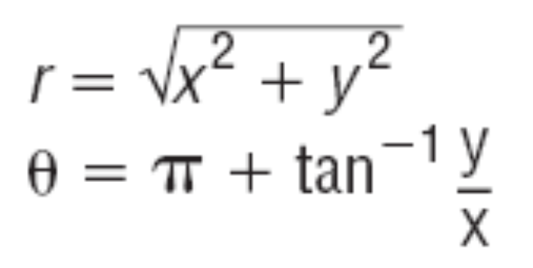
Copyright © 2012 Pearson Education, Inc. Publishing as Prentice Hall.

Slide 21
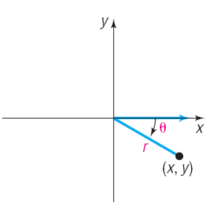
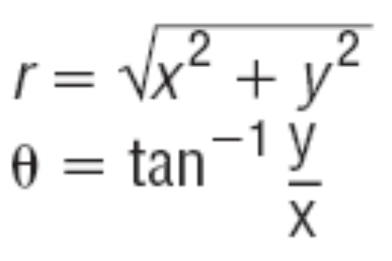
Copyright © 2012 Pearson Education, Inc. Publishing as Prentice Hall.

Slide 22

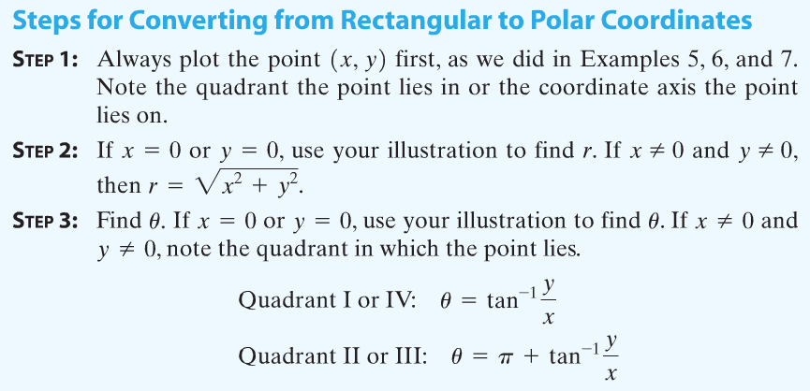
Copyright © 2012 Pearson Education, Inc. Publishing as Prentice Hall.

Slide 23
Copyright © 2012 Pearson Education, Inc. Publishing as Prentice Hall.

Slide 24




This is a circle.
Copyright © 2012 Pearson Education, Inc. Publishing as Prentice Hall.

Slide 25




Copyright © 2012 Pearson Education, Inc. Publishing as Prentice Hall.

